Slide 1
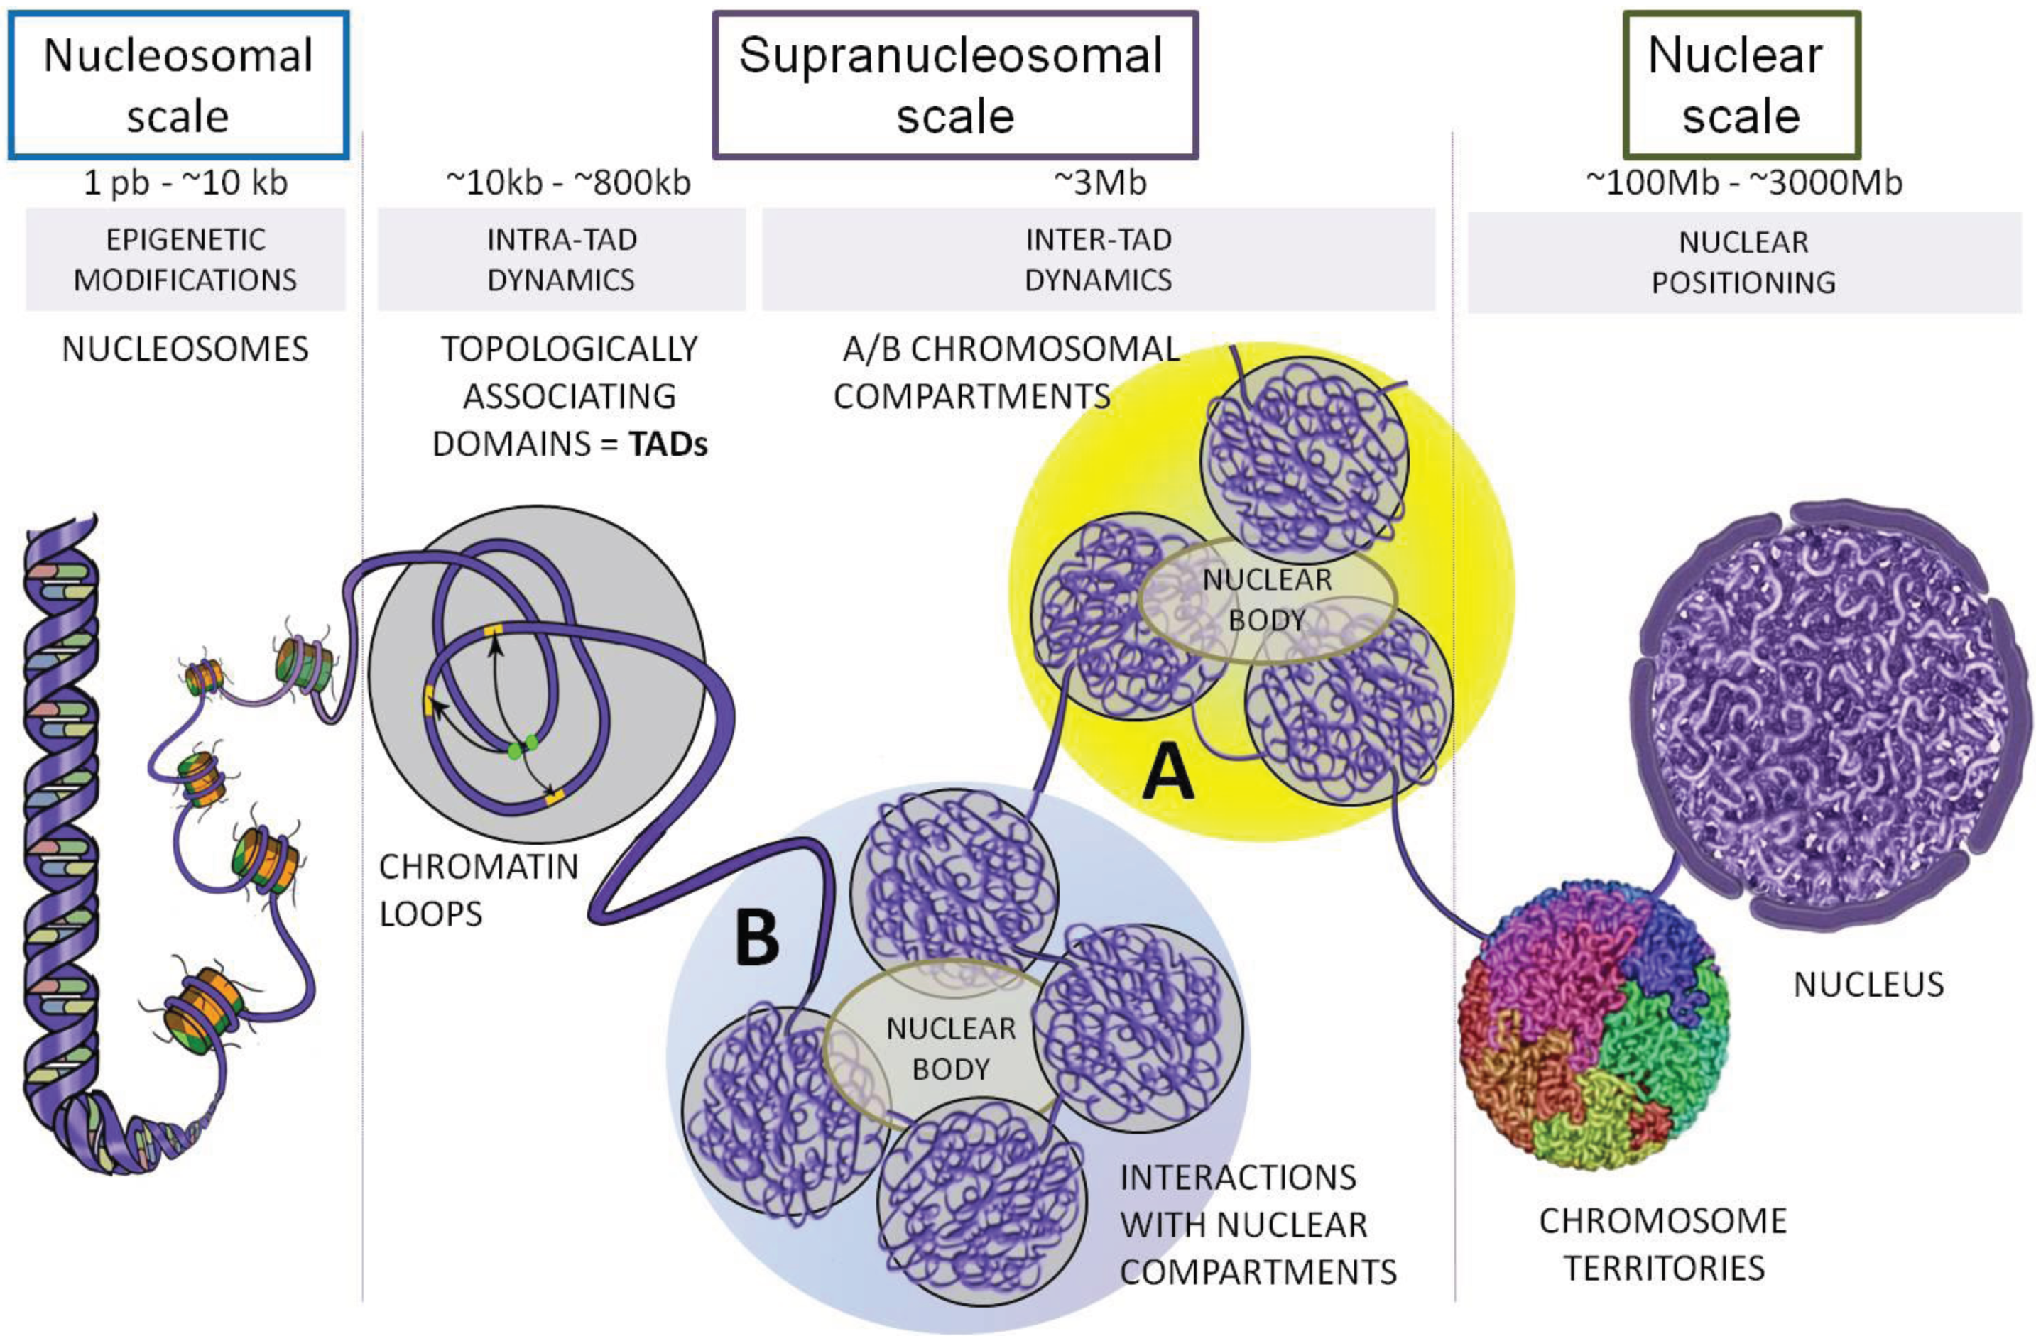
The 3D genome
Ea V, Baudement MO, Lesne A, Forné T. Contribution of Topological Domains and Loop Formation to 3D Chromatin Organization. Genes (Basel). 2015;6(3):734-50.

Slide 2
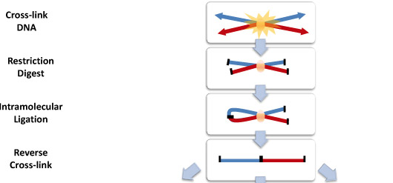
Chromatin Conformation Capture
Used to measure proximity of genomic regions in space
Common basis for all “C” techniques:

Slide 3
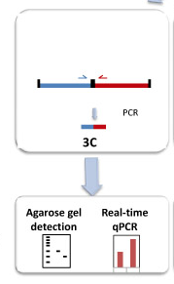
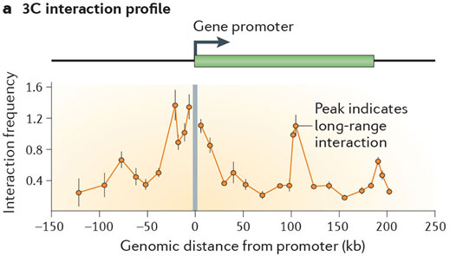
3C
Chromosome
Conformation
Capture
“One versus one”
Real-time PCR for quantification of ligation product
Requires knowledge of both interacting loci for primer
design.

Slide 4
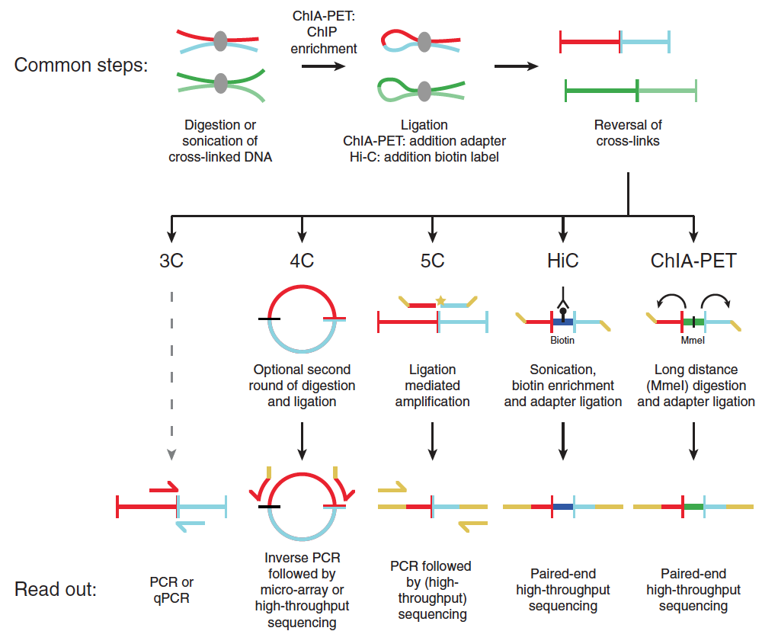
4C
Circularized
Chromosome
Conformation
Capture
“One versus all”
Ligation products are circularized
Inverse PCR: Only requires knowledge of 1 locus
Readout on micro-array or
high-throughput sequencing
Noordermeer D, Duboule D. Chromatin looping and organization at developmentally regulated gene loci. Wiley Interdiscip Rev Dev Biol. 2013;2(5):615-30.

Slide 5
Carbon
Copy
Chromosome
Conformation
Capture
5C
“Many versus many”
Needs primers for all restriction fragments
Unsuitable for whole genome analyses
Maps interactions between all restriction fragments within a given region
Dekker J, Marti-renom MA, Mirny LA. Exploring the three-dimensional organization of genomes: interpreting chromatin interaction data. Nat Rev Genet. 2013;14(6):390-403.

Slide 6
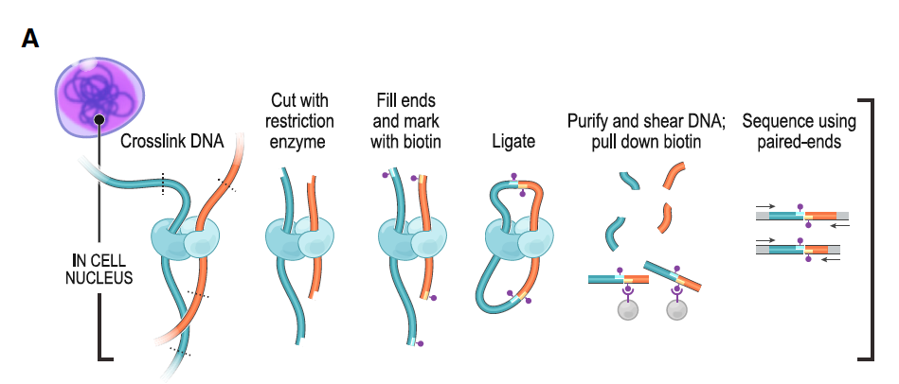
Hi-C
“All versus all”
Biotin labeling before ligation.
High throughput sequencing
Rao et al, 2014. A 3D map of the human genome at kilobase resolution reveals principles of chromatin looping. Cell

Slide 7
ChIP-seq based techniques
Looking specifically at interactions with a protein of interest (e.g CTCF, PolII,...)
ChIP loop
Chip-seq + 3C
ChIA-PET
Chromatin Interaction Analysis
by Paired End Sequencing
ChIP seq + 5C

Slide 8
Interpreting Hi-C data: TADs
A
B
C
D
 | A | B | C | D
A
B
C
D
TAD:

Slide 9
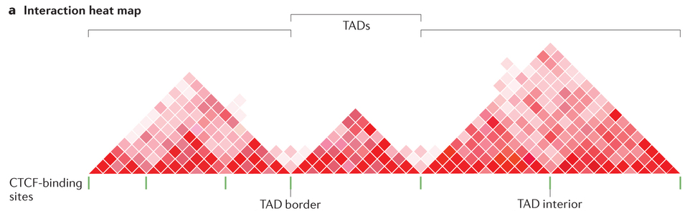
TADs
Area of high chromosomal contacts.
Start and end points of TADs are called “borders”
Regions around borders are called boundaries.
Boundaries are region of high intra-TAD contact that act as insulators, preventing inter-TAD contacts.
TAD boundaries

Slide 10
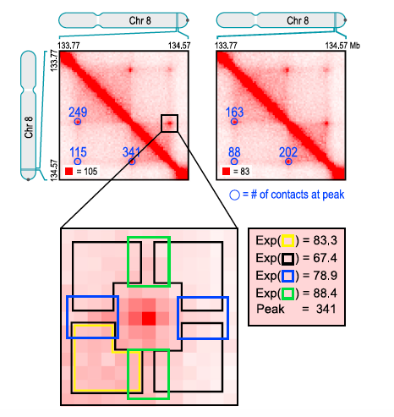
Interpreting Hi-C data: Loops
A
B
C
D
Anchors
 | A | B | C | D
A
B
C
D

Slide 11
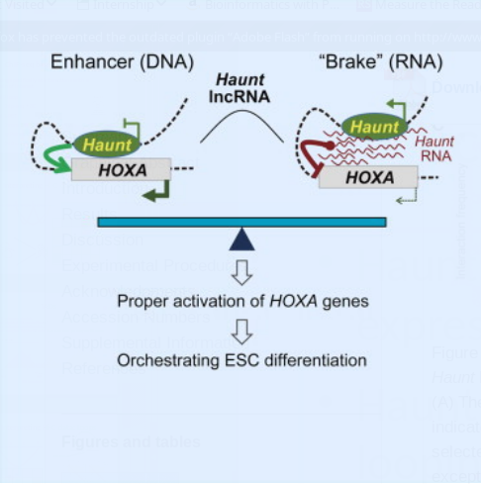
ncRNAs and spatial organization
Haunt: induce/repress HOXA genes expression depending on spatial organization
Haunt RNA is thought to inhibit chromosomal looping by binding HOXA genes.
Haunt DNA acts as enhancer for HOXA genes through chromosomal looping.
Yin Y, Yan P, Lu J, et al. Opposing Roles for the lncRNA Haunt and Its Genomic Locus in Regulating HOXA Gene Activation during Embryonic Stem Cell Differentiation. Cell Stem Cell. 2015;16(5):504-16.

Slide 12
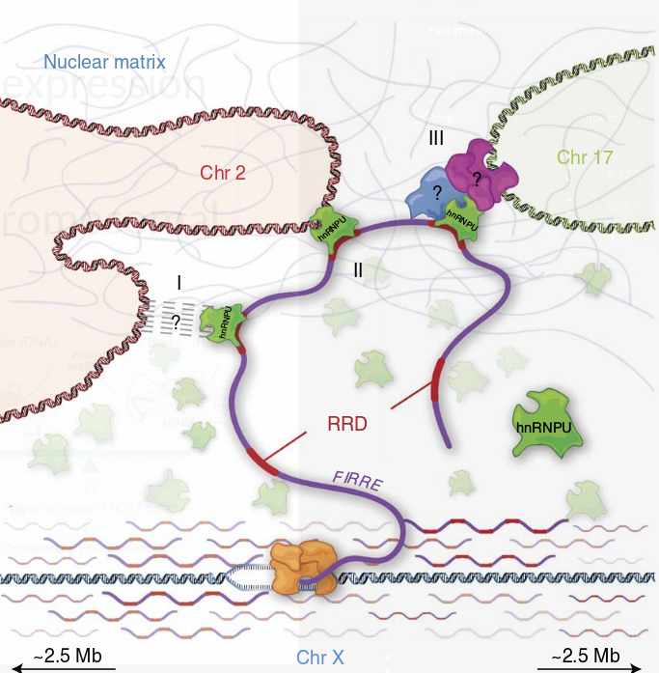
ncRNAs and spatial organization
Firre: lincRNA reorganizing chromosomal architecture.
Anchors the inactive X chromosome to the nucleolus through CTCF/cohesin binding.
Only the locus on the Xi binds CTCF
Transcript is also bound by CTCF
Promotes formation of trans-chromosomal contacts through binding of hnRNPU, a nuclear matrix factor, via a Repeating RNA Domain.
Hacisuleyman E, Goff LA, Trapnell C, et al. Topological organization of multichromosomal regions by the long intergenic noncoding RNA Firre. Nat Struct Mol Biol. 2014;21(2):198-206.
Yang F, Deng X, Ma W, et al. The lncRNA Firre anchors the inactive X chromosome to the nucleolus by binding CTCF and maintains H3K27me3 methylation. Genome Biol. 2015;16:52.

Slide 13
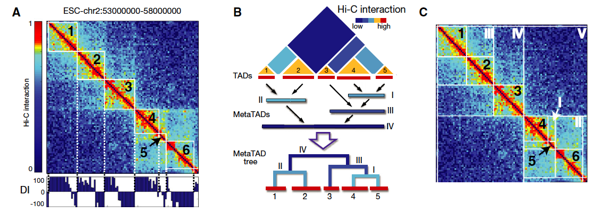
Ambiguous definitions
What amount of contact required to call a loop?
TADs are embedded in larger TADs.
Dynamic structures are hidden by Hi-C
Interest of single-cell Hi-C

